Slide 1
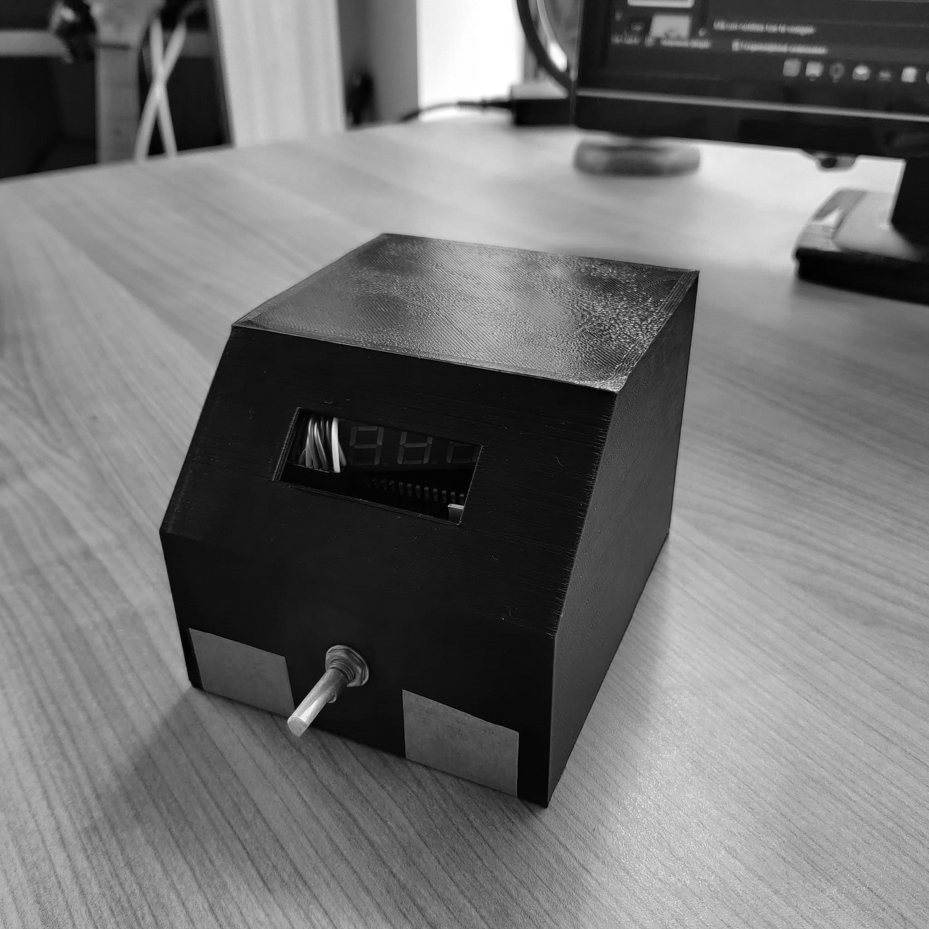
Soldering station 2023
Mauro De Bruyn
07/06/2023
Notes:
2nd design -> last one design faults

Slide 2
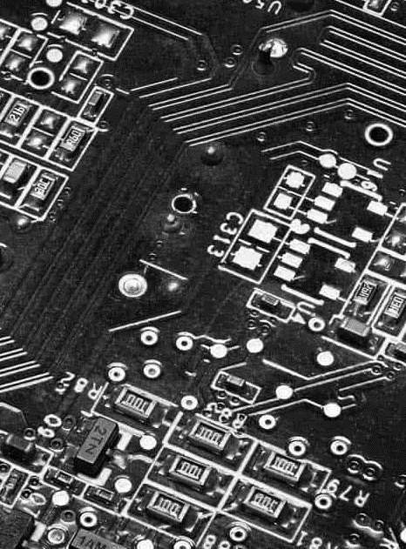
Introduction
Left hand use (soldering iron)
Encoder
Display sloped edge
On/Off switch
External fuse

Slide 3
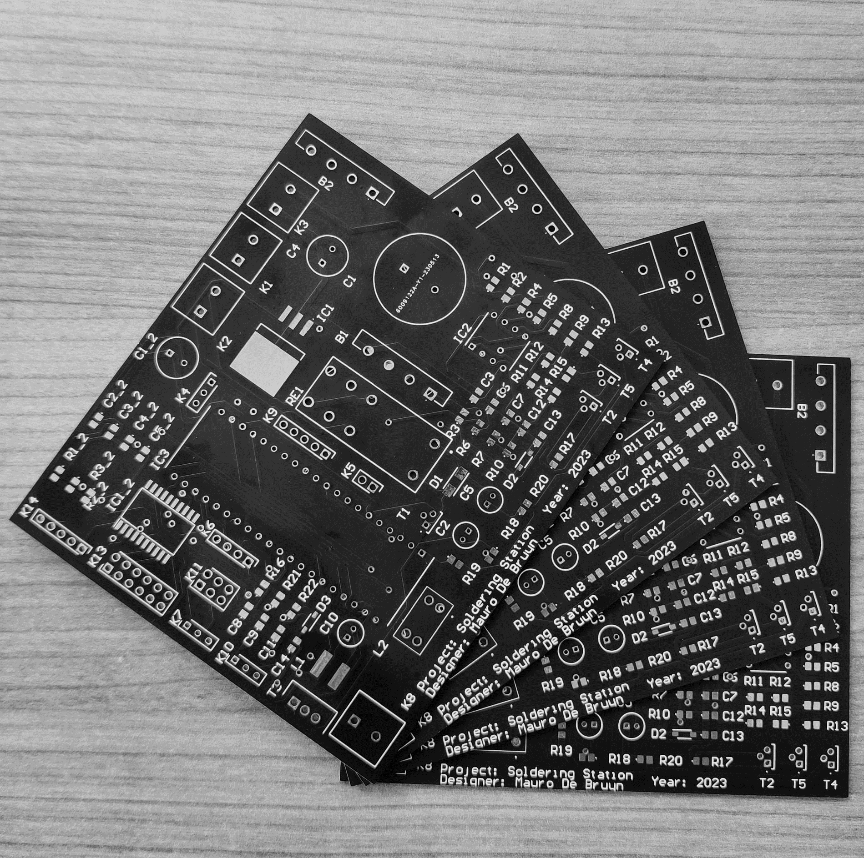
Steps
Schematics (Elektor)
PCB (Altium)
Case (Autodesk Fusion)

Slide 4
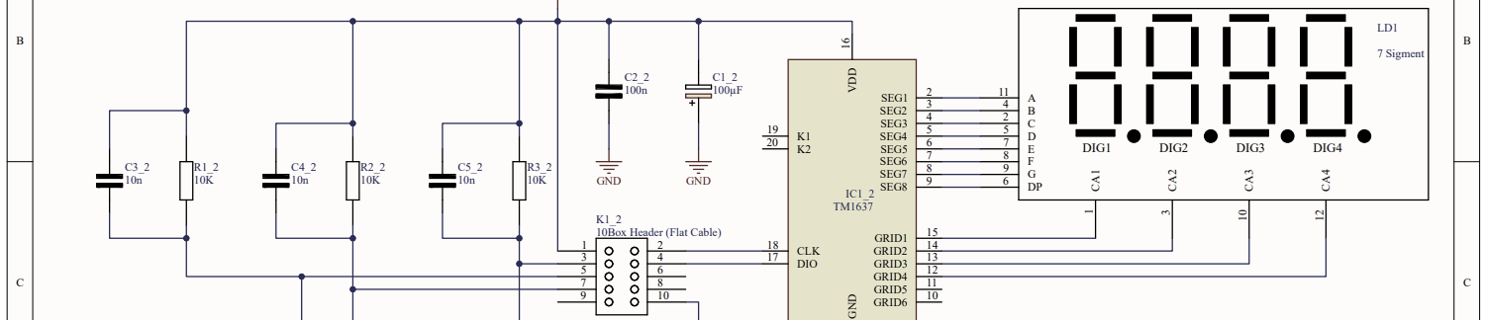
Schematics
Elektor
Altium designer
5 Schemes

Slide 5
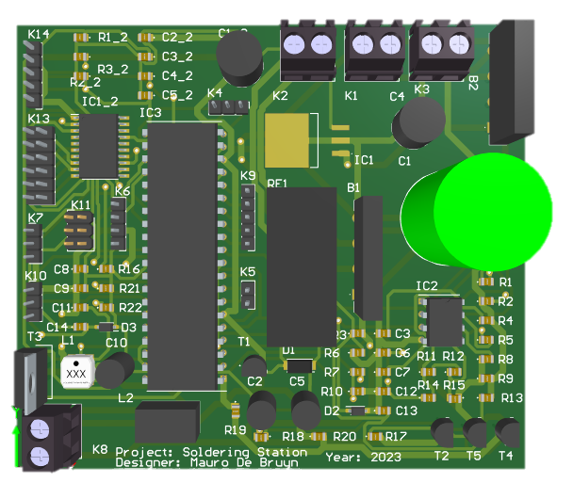
PCB
Altium
Power lines
External components

Slide 6
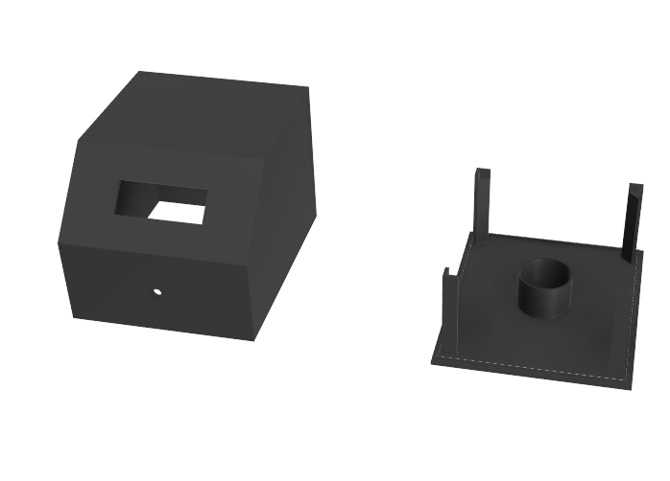
Case
Autodesk Fusion 360
Sloped edge
Left hand use
Cylinder for transformer

Slide 7

Problems
Broken processor
Solder wrong components (Capacitor, transistor)
Small case

Slide 8
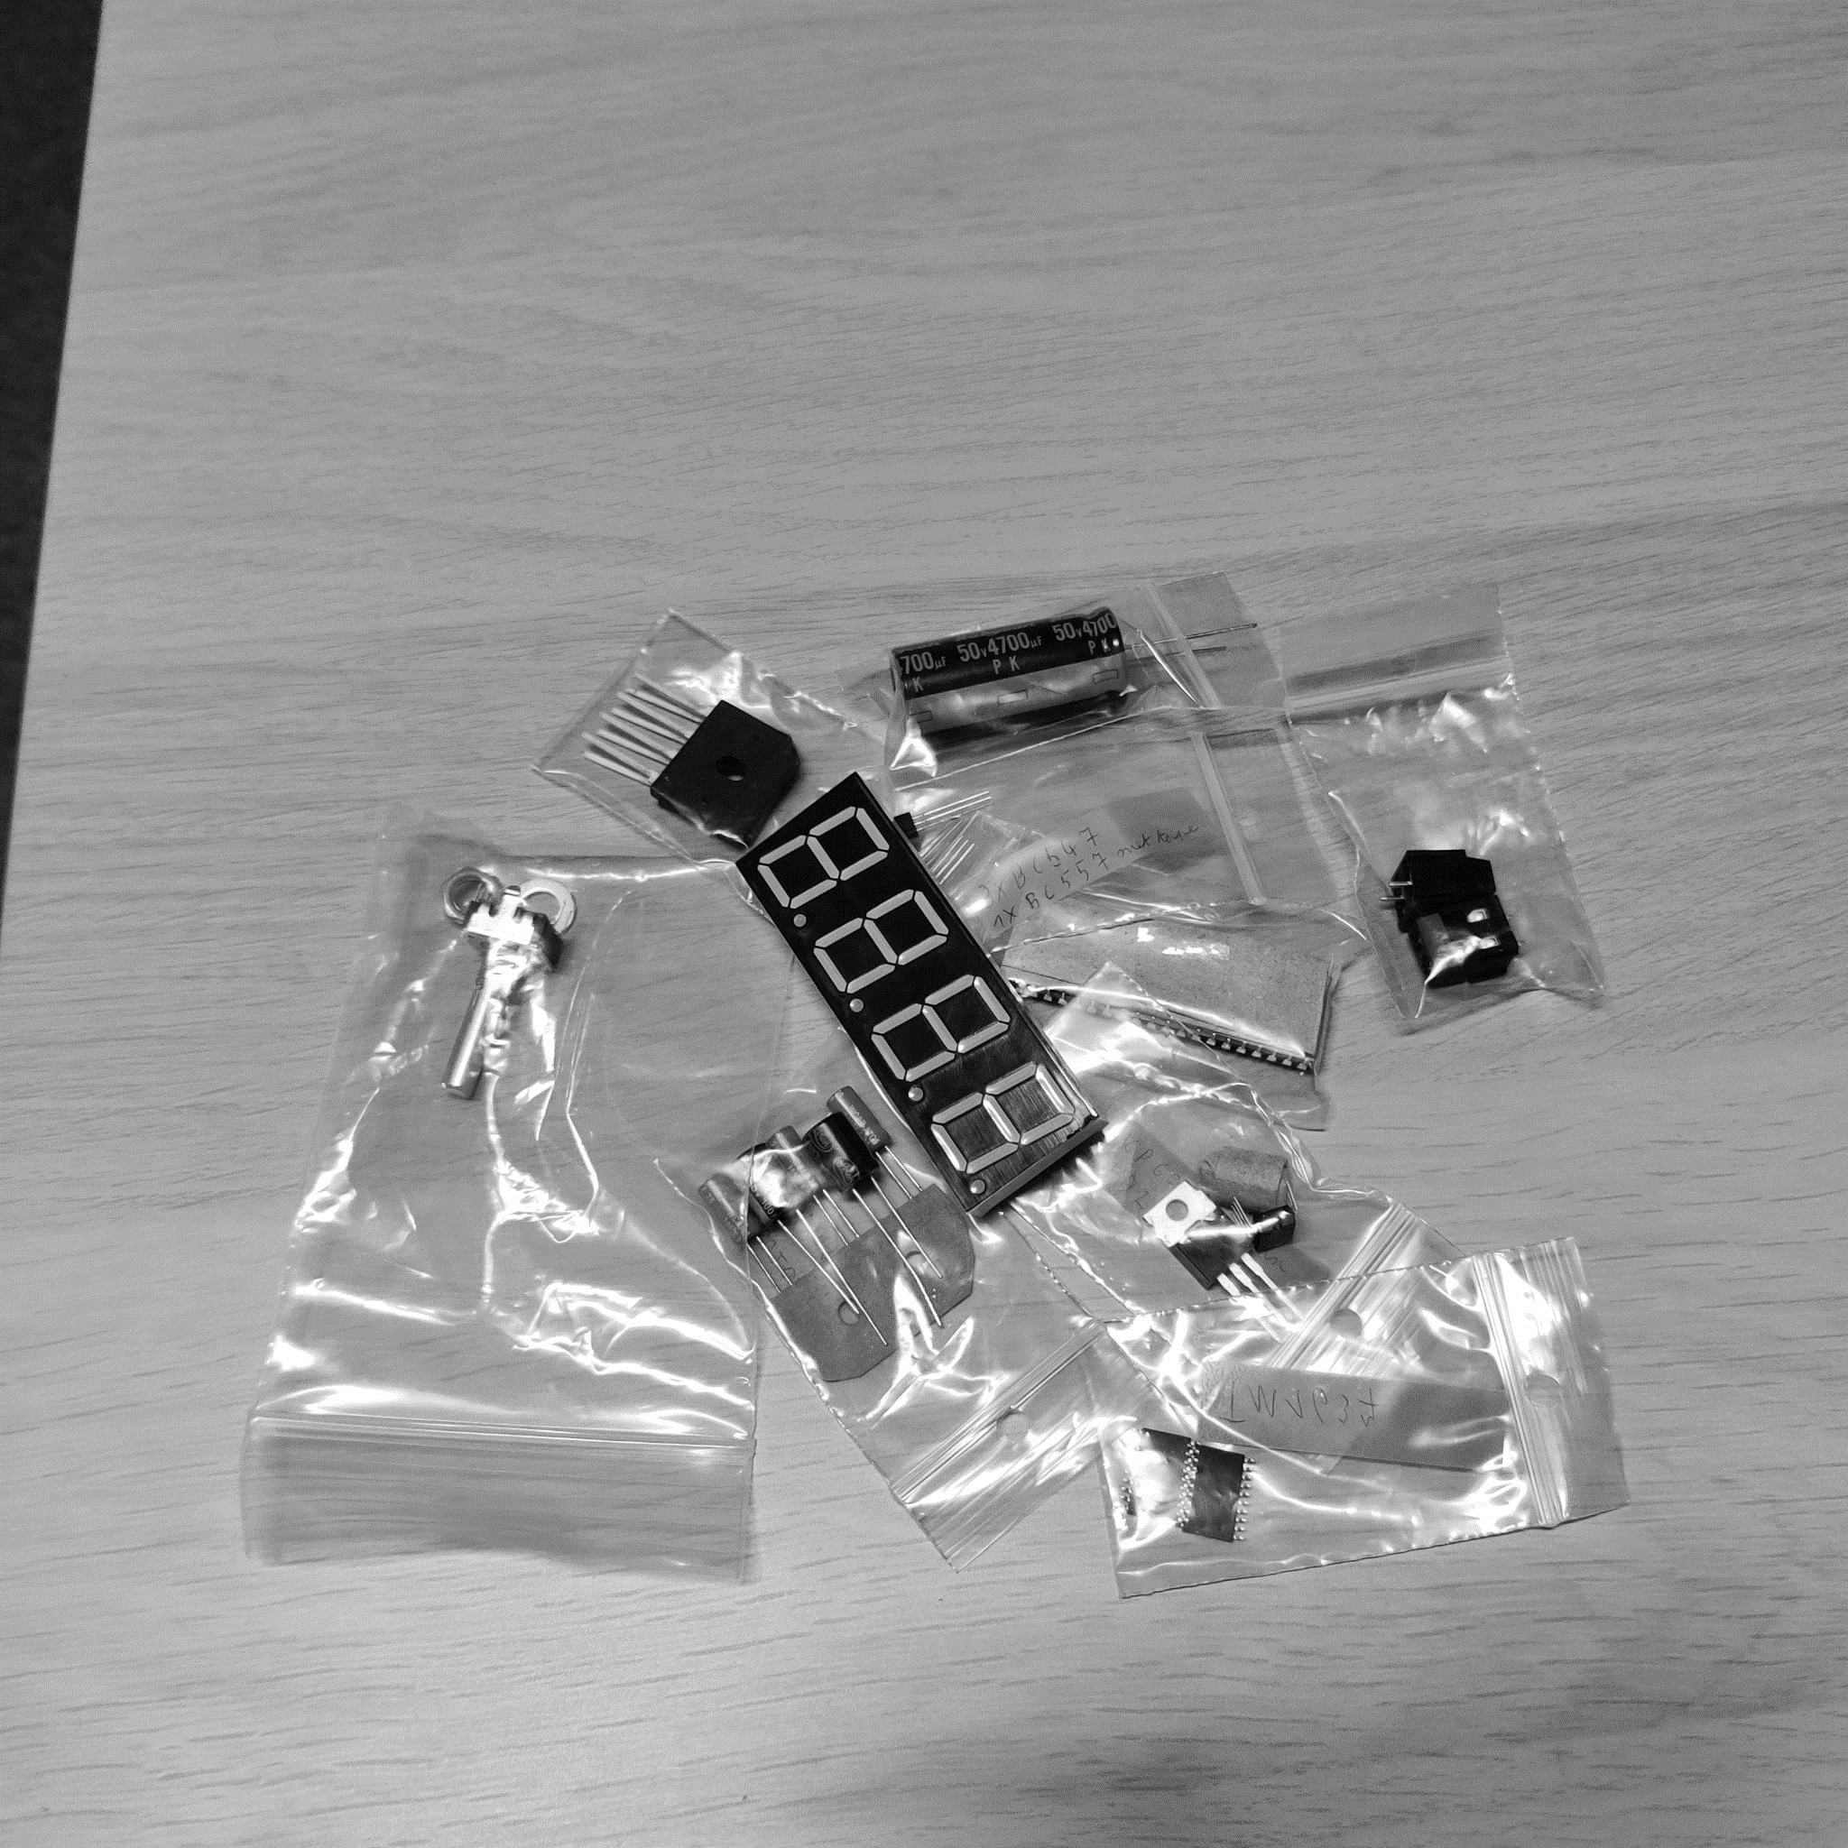
Overall
2nd version
Faster design (programs)

Slide 9
Questions?

